Slide 1
Graphs Data Structure
Lecture important

Slide 2
Definition
A graph is a non linear data structure.
You’re traveling from one city to another city and the city is called node and the way / path on which you are driving your car is said to be an edge.
A graph is basically used to represent a network.
Generally in graphs we called nodes as “Vertices” and the connection between the vertices is said to be an “edge”.
G = (V, E)

Slide 3
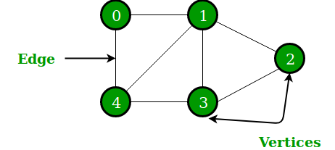
Example
Notes:
From this example we can see that the graph has vertices as V(0,1,2,3,4) and the edges have E(0,1),(0,4),(1,2),(1,3),(2,3),(3,4)(1,4)

Slide 4
Types of graphs
There are following types of graphs:
Directed graphs(in which the direction is given from vertices to an other vertices through an edge)
Un directed graph( in which no direction is given as in the above example)
Weighted graph (in which we mention weight (distance, etc) is called weighted graph)
Loop graph (graph having same starting and end point is called a loop graph)

Slide 5
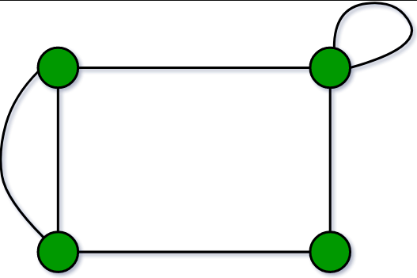
Loop graph example

Slide 6
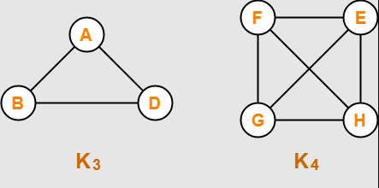
Complete graph
In complete graph every node is adjacent to an other node.

Slide 7
How to calculate number of edges from a complete graph?
The procedure to calculate the number of edges from the complete graph is as:
First calculate the nodes of the compete graph i.e. n
Then implement the formula:
Edges = n(n-1) /2

Slide 8
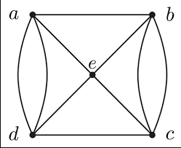
Multigraphs
If there are more than one edges between two nodes/vertices such graph is known as multigraph.

Slide 9
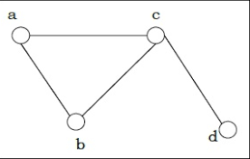
Connected / non connected graphs
If nodes are connected with each other through the edges then the graph is said to be connected graph if any single node is not connected via any edge such edge is said to be a non-connected graph.

Slide 10
Representations of the graph
There are two methods to represent a graph is:
1- Adjacency Matrix(matrix concept 2-D array)(Sequential representation)
2- Adjacency List(Linked list concept)(Linked representation)
.

Slide 11
Sequential representation
Adjacency matrix:
We can represent the graph G having n node with matrix A =(a ij)[n x n matrix]
a(ij) ={1 if ni is adjacent to nj, that is if there is an edge (ni, nj), otherwise 0}

Slide 12
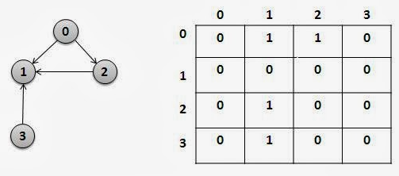
Adjacency matrix example

Slide 13
Linked representation
Adjacency List:
It contains two lists
Node list →
Edge List →
Node | Next | Adj
Destination(DEST) | Link

Slide 14
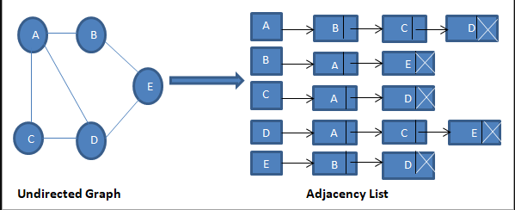
Adjacency List example

